Slide 1
FLAT: Chinese NER Using Flat-Lattice Transformer
Xiaonan Li, Hang Yan, Xipeng Qiu, Xuanjing Huang
Shanghai Key Laboratory of Intelligent Information Processing, Fudan University
School of Computer Science, Fudan University
Github: https://github.com/LeeSureman/Flat-Lattice-Transformer
ACL-2020
罗辉

Slide 2
Introduction

Slide 3
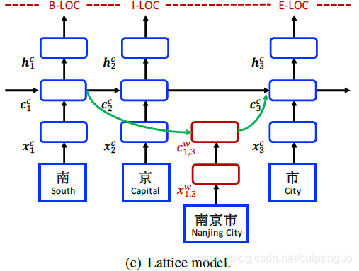
Lattice-LSTM
每个字符只能获得以它为结尾的词汇信息。
Lattice-LSTM没有利用前一时刻的记忆向量，即不保留对词汇信息的持续记忆。
计算性能低下，不能batch并行计算。

Slide 4
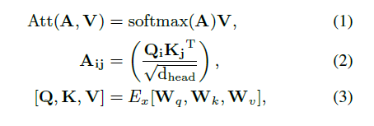
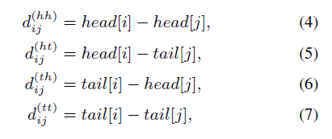
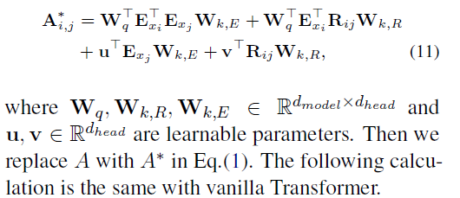
Methods

Slide 5
Experiment

Slide 6
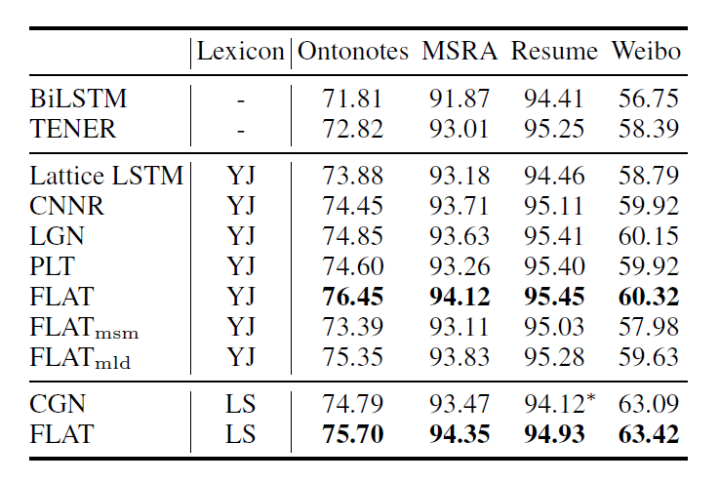

Slide 7
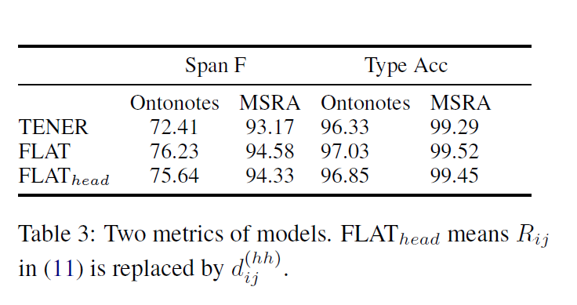

Slide 8
